Slide 1
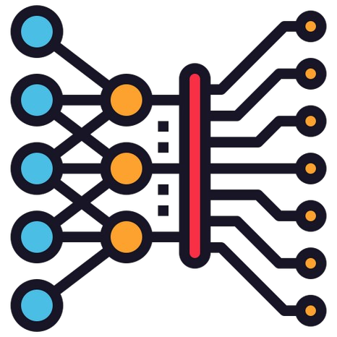
Introduction to Deep Learning

Slide 2
What is Deep Learning?
In machine learning, deep learning focuses on utilizing multilayered neural networks to perform tasks such as classification, regression, and representation learning. The field takes inspiration from biological neuroscience and is centered around stacking artificial neurons into layers and "training" them to process data. The adjective "deep" refers to the use of multiple layers (ranging from three to several hundred or thousands) in the network

Slide 3
Deep Learning
•
Modern deep learning models use artificial neural networks or simply neural networks to extract information.
These neural networks are made up of a simple mathematical function that can be stacked on top of each other and arranged in the form of layers, giving them a sense of depth, hence the term Deep Learning.
Deep learning can also be thought of as an approach to Artificial Intelligence, a smart combination of hardware and software to solve tasks requiring human intelligence.
•
•

Slide 4
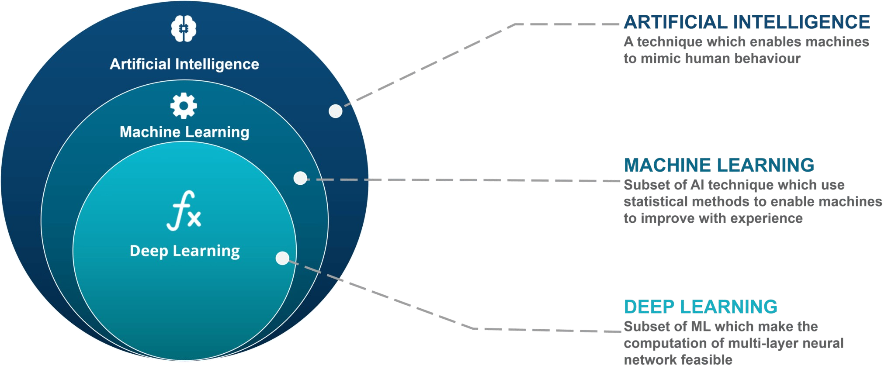
Deep Learning

Slide 5
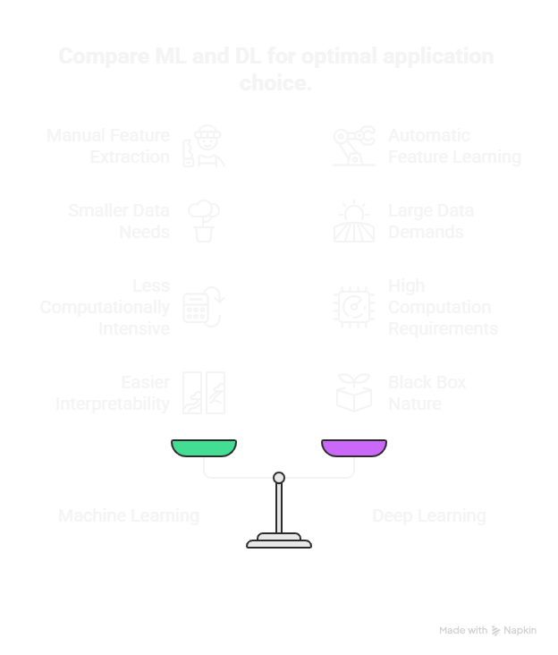

Slide 6
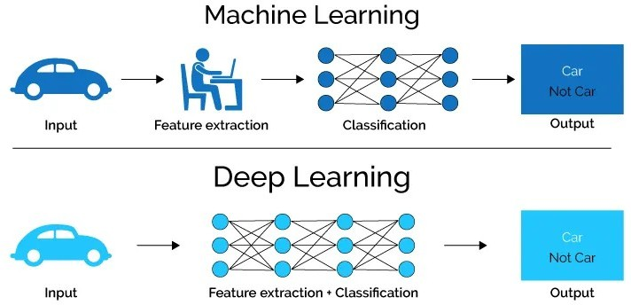
Deep Learning vs. Machine Learning

Slide 7
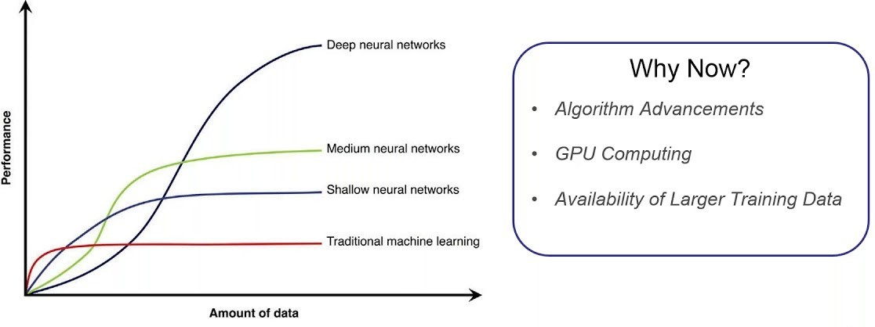
Why Deep Learning ?

Slide 8
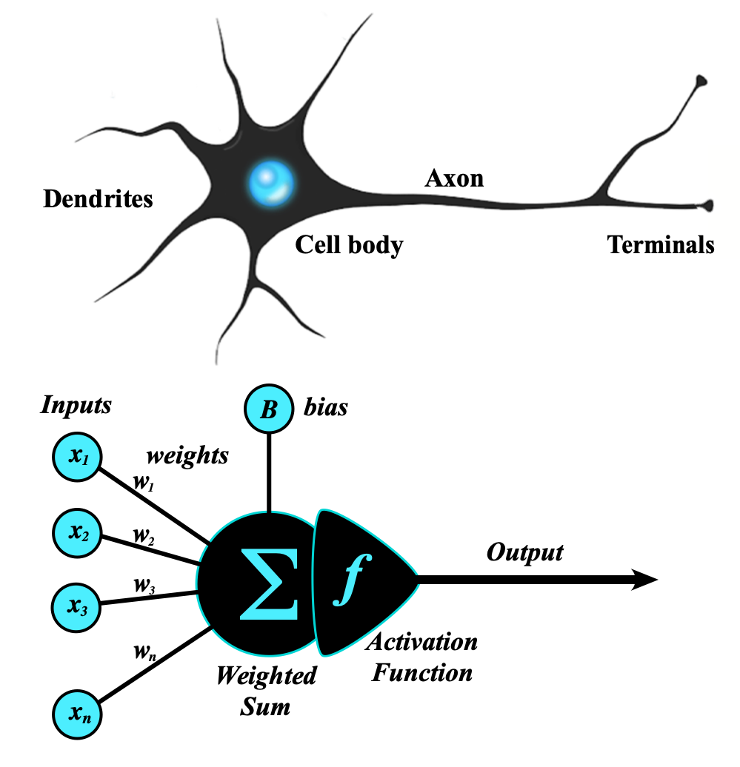
The Concept of perceptron

Slide 9
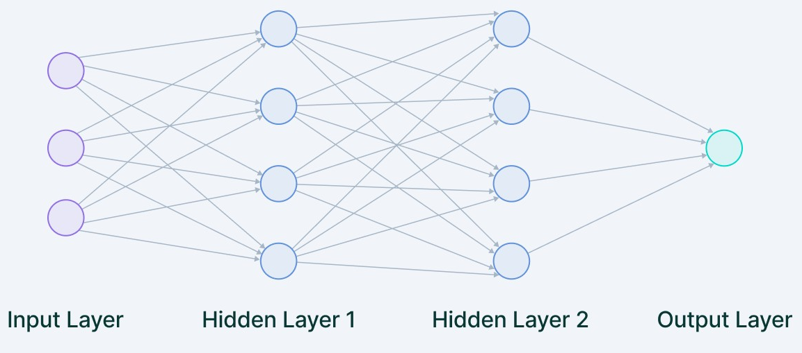
How does Deep Learning work?

Slide 10
Types of Neural Network
•
•
•
Artificial Neural Network (ANN) Convolutional Neural Network (CNN)
Recurrent Neural Network (RNN)

Slide 11
CNN
The Convolutional Neural Networks or CNNs are primarily used for tasks related to computer vision or image processing.
CNNs are extremely good in modeling spatial data such as 2D or 3D images and videos.
They can extract features and patterns within an image, enabling tasks such as image classification or object detection.

Slide 12
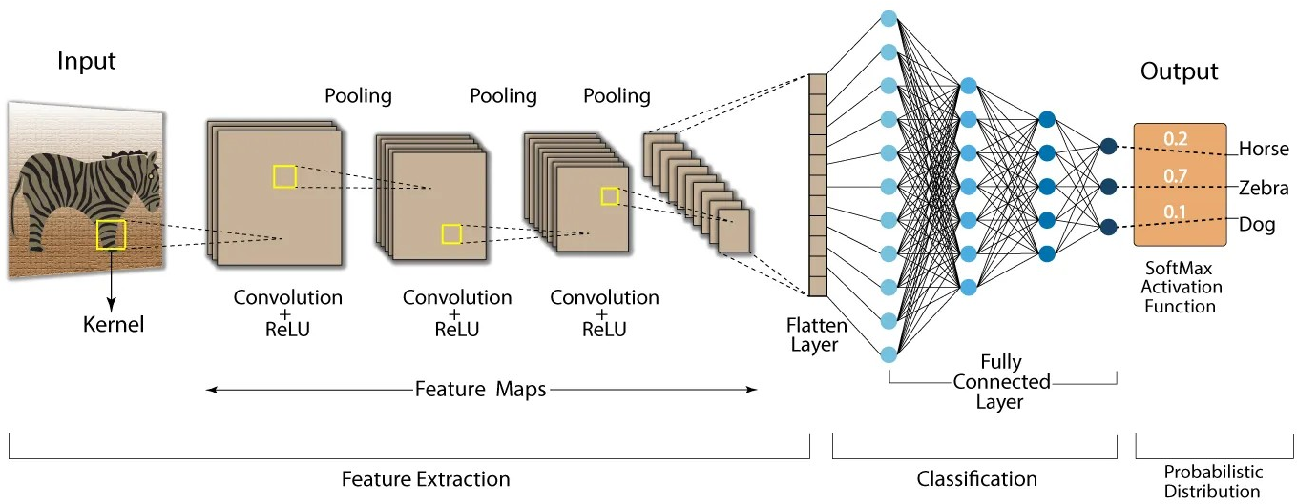

Slide 13
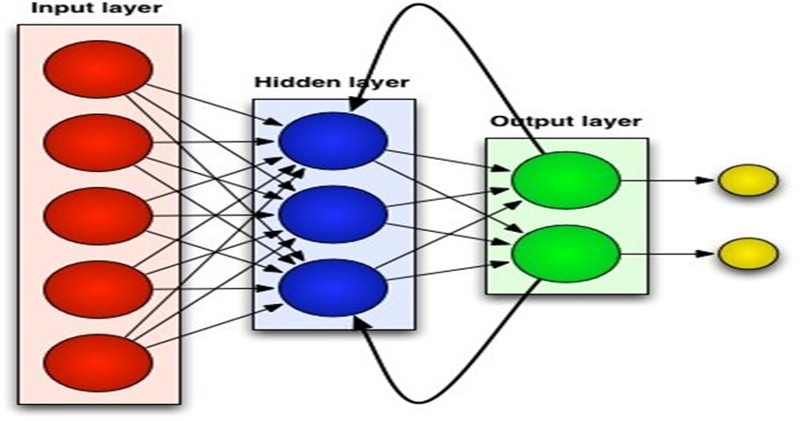
RNN
The Recurrent Neural Networks or RNN are primarily used to model sequential data, such as text, audio, or any type of data that represents sequence or time.
They are often used in tasks related to natural language processing (NLP).

Slide 14
GAN
•
Generative adversarial networks or GANs are frameworks that are used for the tasks related to unsupervised learning.
This type of network essentially learns the structure of the data, and patterns in a way that it can be used to generate new examples, similar to that of the original dataset.
•

Slide 15
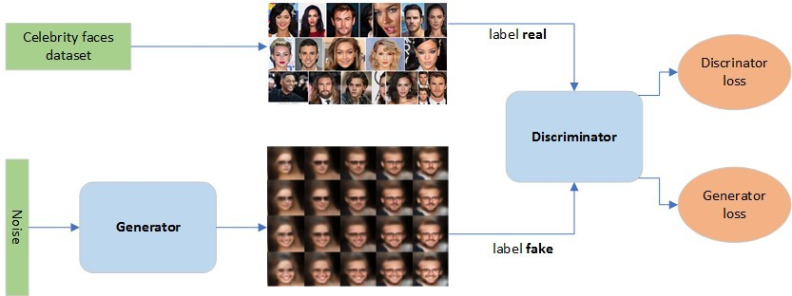

Slide 16
Transformers
•
Transformers are the new class deep learning model that is used mostly for the tasks related to modeling sequential data, like that in NLP.
It is much more powerful than RNNs and they are replacing them in every task.
Recently, transformers are also being applied in computer vision tasks and they are proving to be quite effective than the traditional CNNs.
•
•

Slide 17
Deep Learning: Limitations
•
•
•
•
•
Data availability
The complexity of the model
Lacks global generalization
Incapable of Multitasking
Hardware dependence

Slide 18
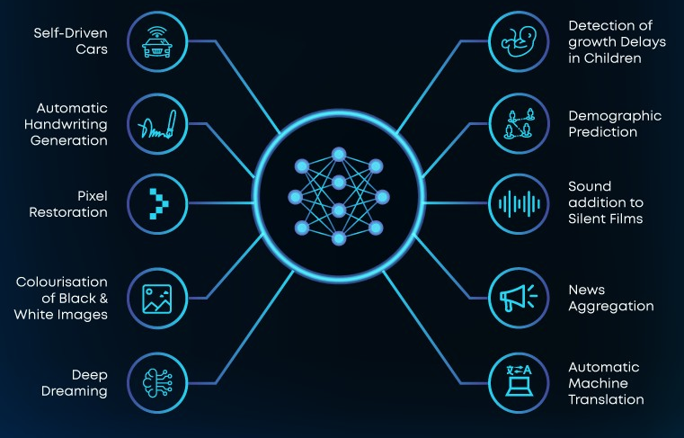
Deep Learning: Applications

Slide 19


Frameworks/libraries

